Slide 1
Machine Learning Lab

Slide 2
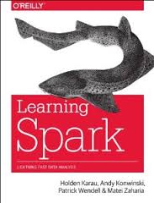
Apache Spark Introduction
Spark is a cluster computing platform designed to be fast and general purpose
fast : computations in memory but also extends MapReduce
general purpose :
batch, interactive queries, algorithms and streaming
APIs in Python, R, Java, Scala and SQL
Integrates other BigData tools: can run in Hadoop clusters and access Hadoop data source, including Cassandra

Slide 3
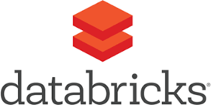
Spark was originally written by researchers at UC Berkeley. The Spark project started in 2009, was open sourced in 2010, and in 2013 its code was donated to Apache, becoming Apache Spark.
Apache Spark is a sophisticated distributed computation framework for executing code in parallel across many different machines.
While the abstractions and interfaces are simple, managing clusters of computers and ensuring production-level stability is not

Slide 4

Big Data Technologies
Origin: Google, Yahoo, Facebook, Twitter, LinkedIn, etc.
Google: Distributed Computation: MapReduce¹ BigTable²
Yahoo (Doug Cutting & Mike Cafarella):
open-source software framework used for…
distributed storage and processing of dataset
computer clusters built from commodity hardware scale-out (robustness)
¹ J. Dean and S. Ghemawat (Google). MapReduce: Simplified Data Processing on Large Clusters. OSDI'04: Sixth Symposium on Operating System Design and Implementation. 2004
² Fay Chang, et al., (Google) Bigtable: A Distributed Storage System for Structured Data Proceedings of OSDI '06, pp. 205–218, 2006

Slide 5
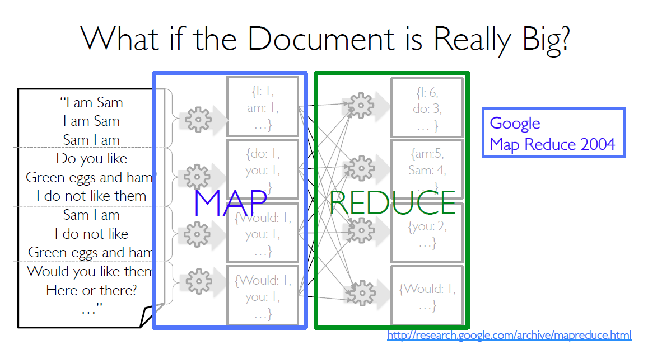
Apache Spark Introduction

Slide 6
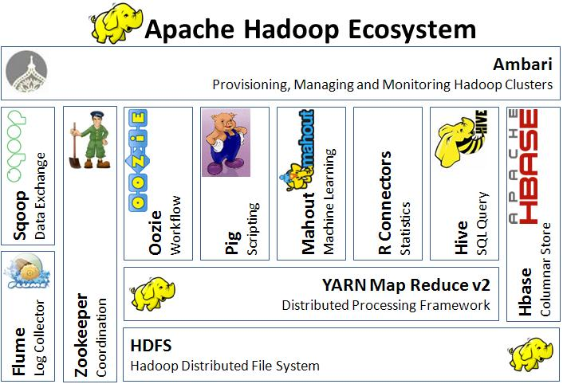
Google: Computación distribuida: MapReduce¹ BigTable²
Yahoo (Doug Cutting & Mike Cafarella): Hadoop
open-source software framework used for distributed storage and processing of dataset
computer clusters built from commodity hardware

Slide 7
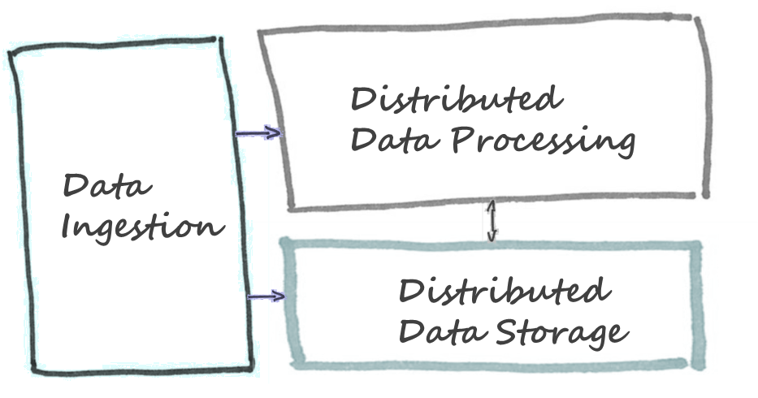


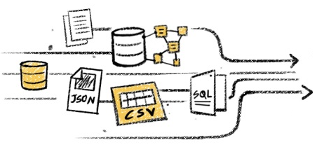
Big Data Architecture
Data Sources
Data Customers
Structured
Non-structured
Business Intelligence
Visualization
Analytics

Slide 8
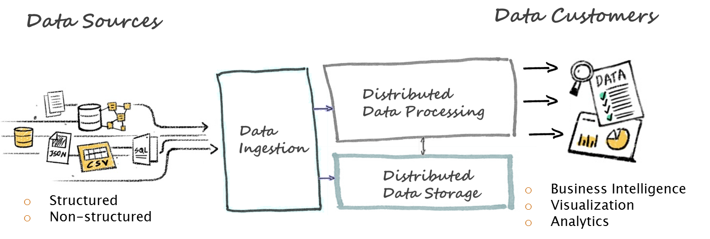


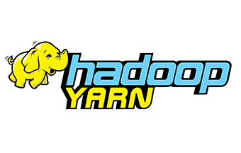






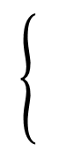
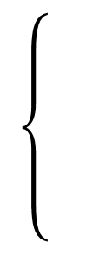
Big Data Architecture
Hw : scalable & robust resource management
Flexibility
Relational
Analytic, Graph
NoSQL
Databases
Data virtualization: to run analytics on data while leaving it where it is located (cloud)

Slide 9

Data Lake
James Dixon

Slide 10
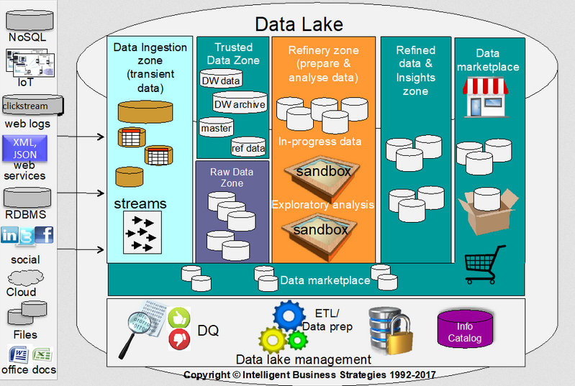
Data governance:
A data lake is of no use unless people know what is in it
… and can access the right data to run analytics
access to trustworthy data to anyone that needs it in a secure and auditable way

Slide 11

Data Swamp!

Slide 12


Big Data Architecture
Beyond MapReduce
In-memory computation
Resilience
Data Processing

Slide 13
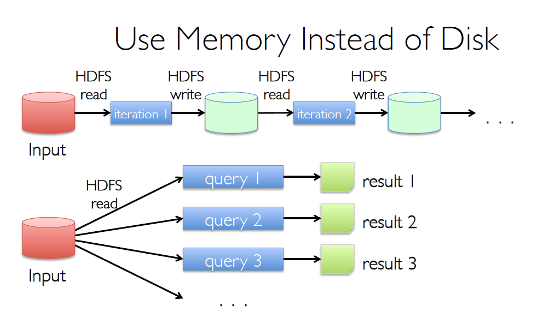
Apache Spark Introduction: Disk vs Memory ----- Hadoop vs Spark

Slide 14
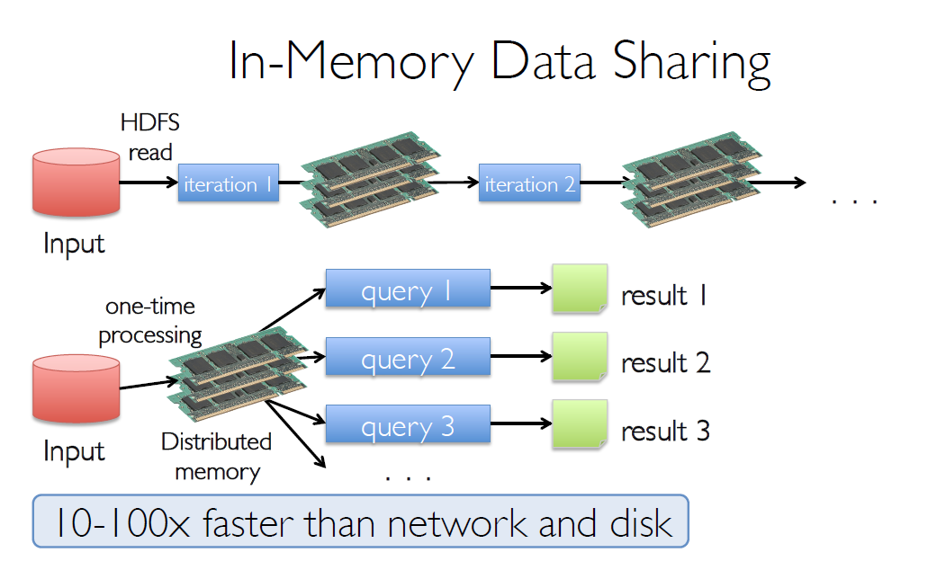
Apache Spark Introduction: Disk vs Memory ----- Hadoop vs Spark

Slide 15
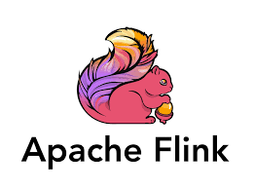

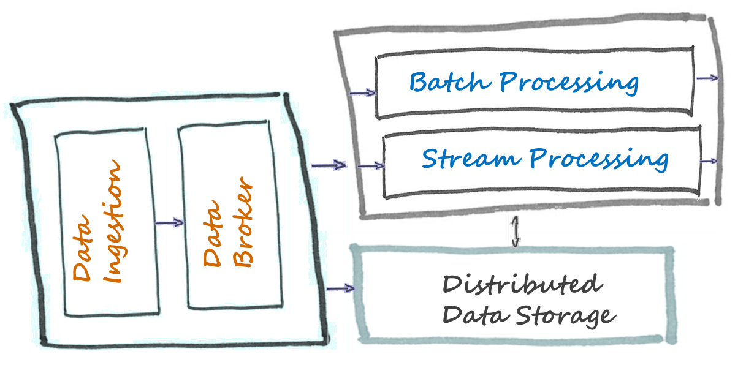
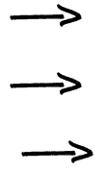
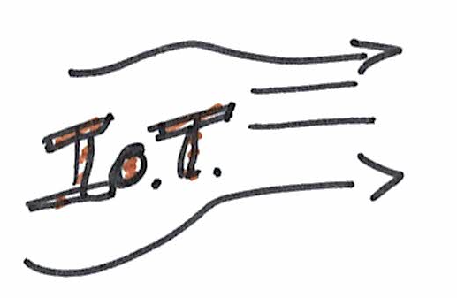
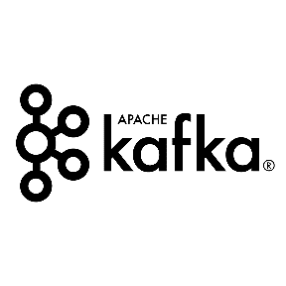


Big Data & IoT Architecture
Data Customers
Data Sources
Business Intelligence
Visualization
Analytics

Slide 16

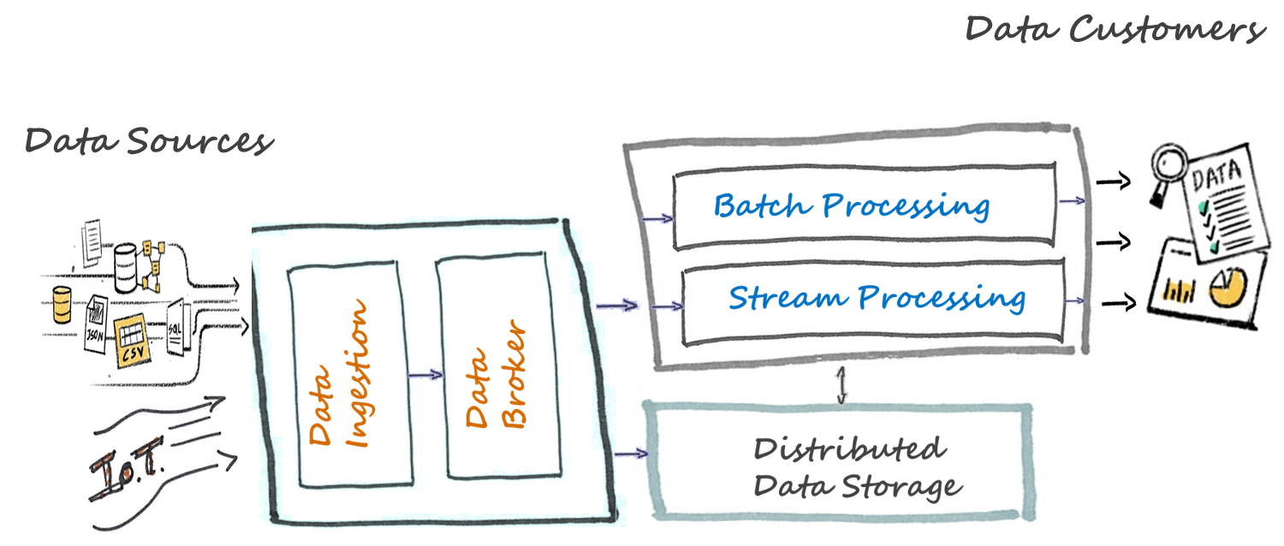


Big Data, IoT & AI

Slide 17
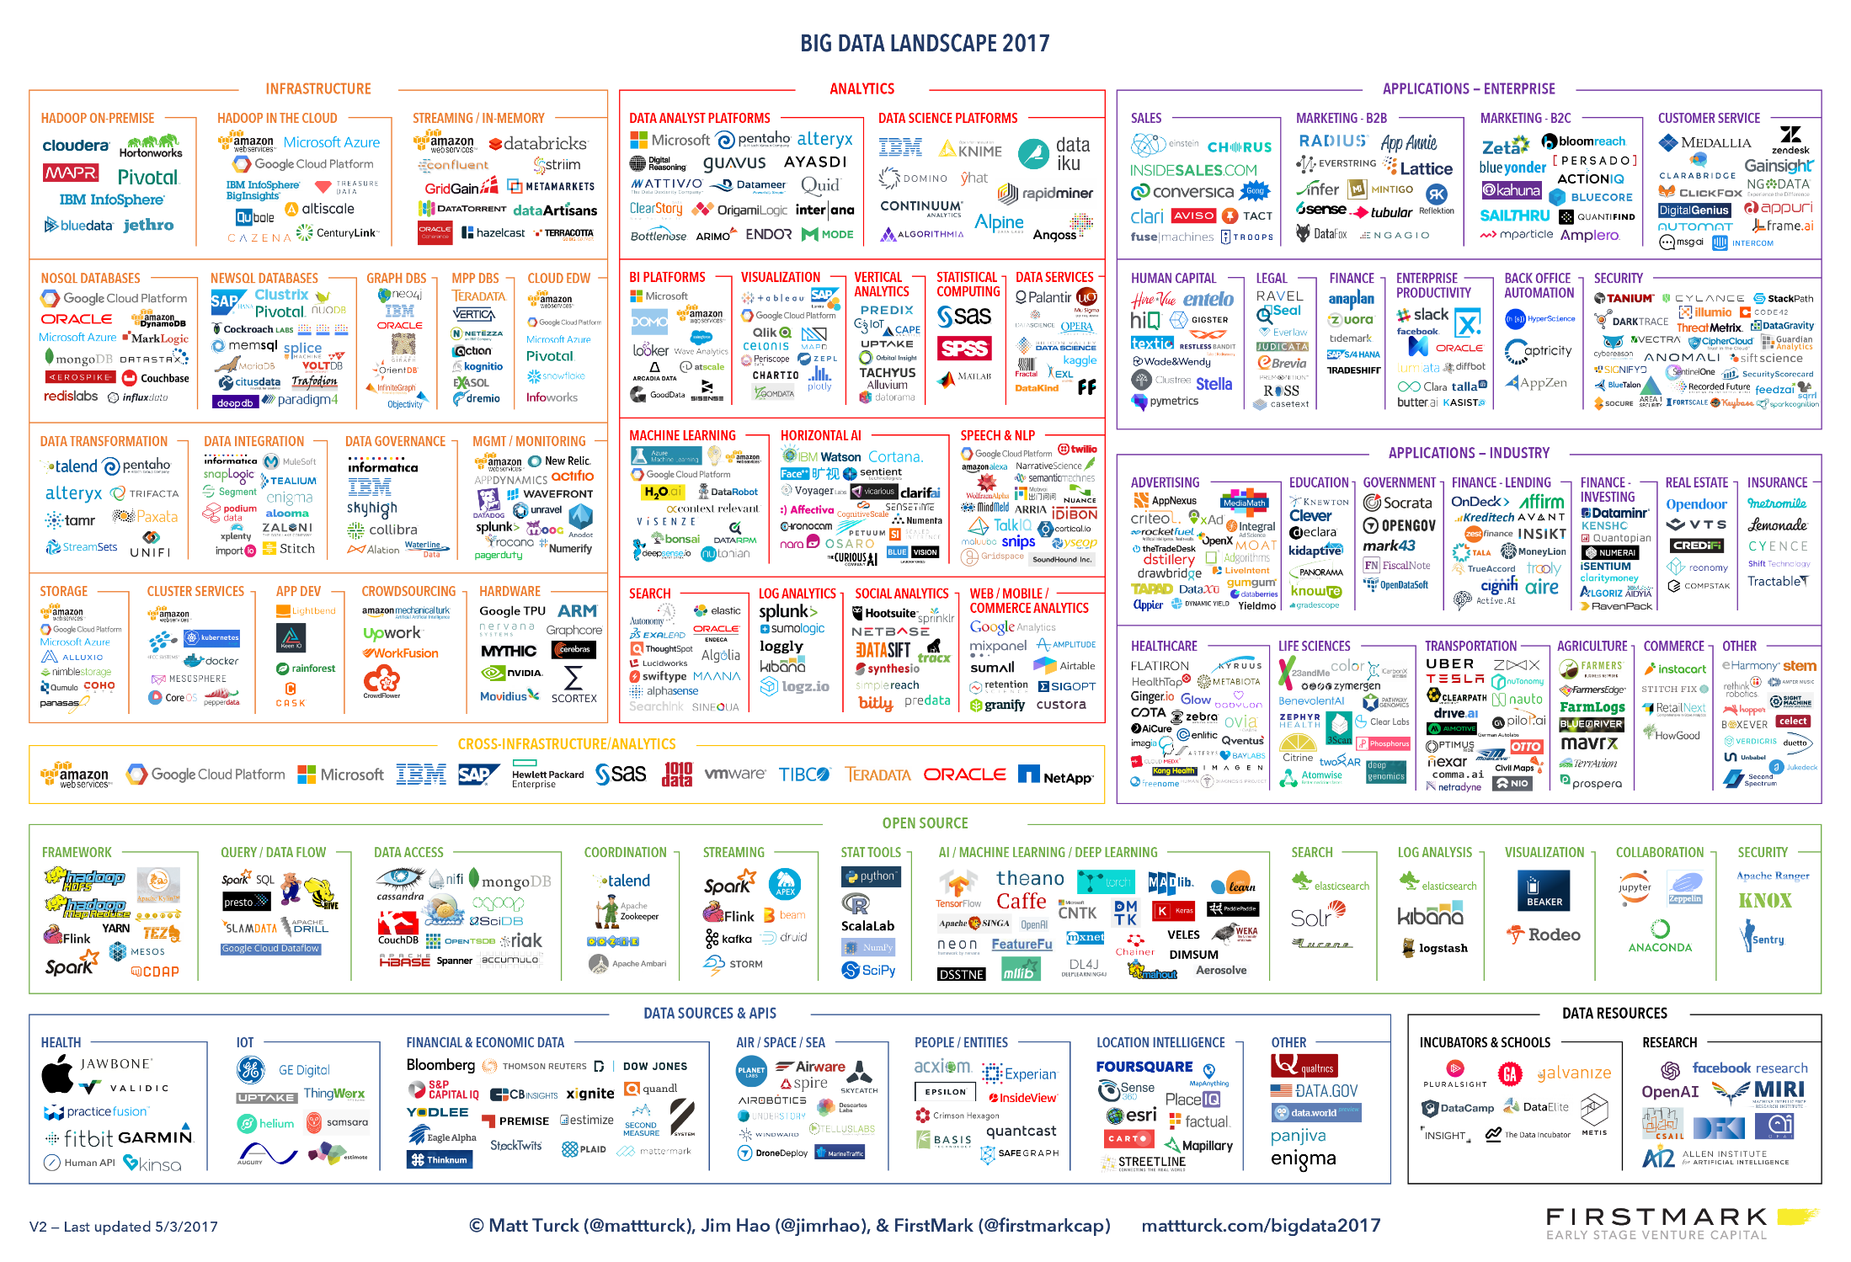

Slide 18

Matei Zaharia
In the course of his PhD studies, he created the Apache Spark project and co-created the Apache Mesos project.
He also designed and implemented the core scheduling algorithms used in Apache Hadoop.
He is a co-founder and chief technologist of Databricks, and an assistant professor of computer science at Stanford University

Slide 19
… intro break, let’s start playing with:

Slide 20
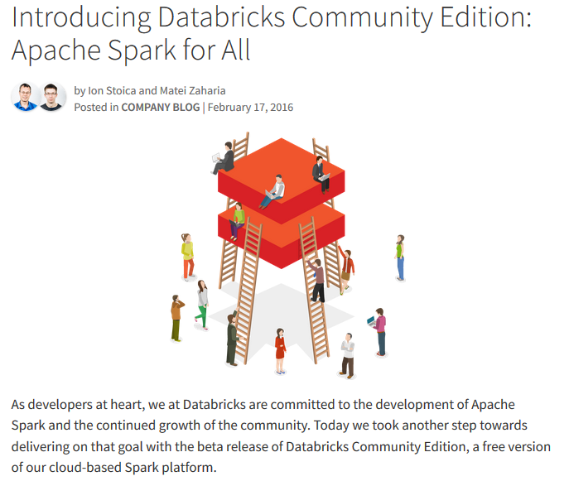

Slide 21
Using Databricks
Sign into Databricks Community Edition
https://community.cloud.databricks.com/

Slide 22
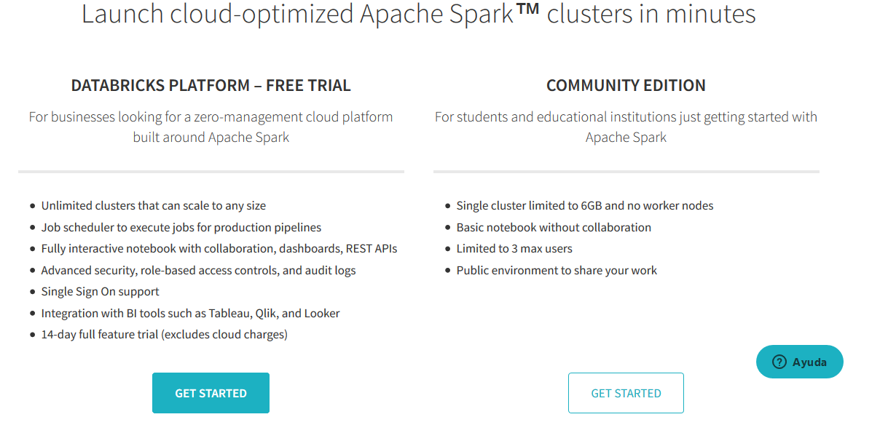

Slide 23
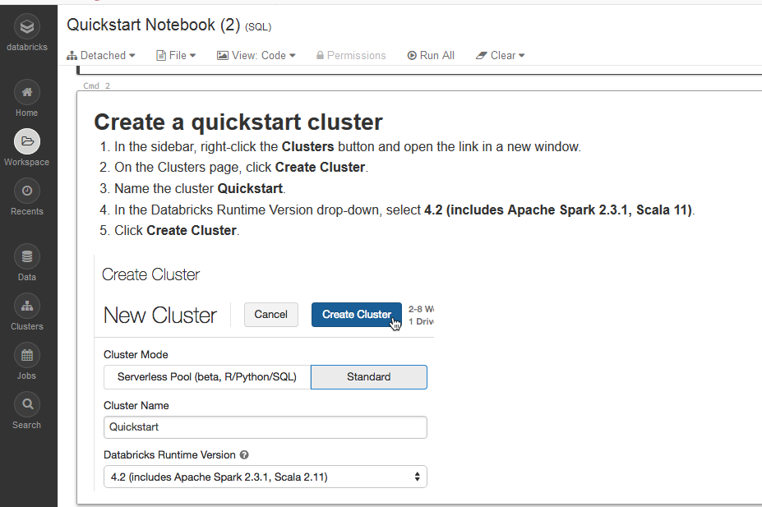

Slide 24


… going back to

Slide 25
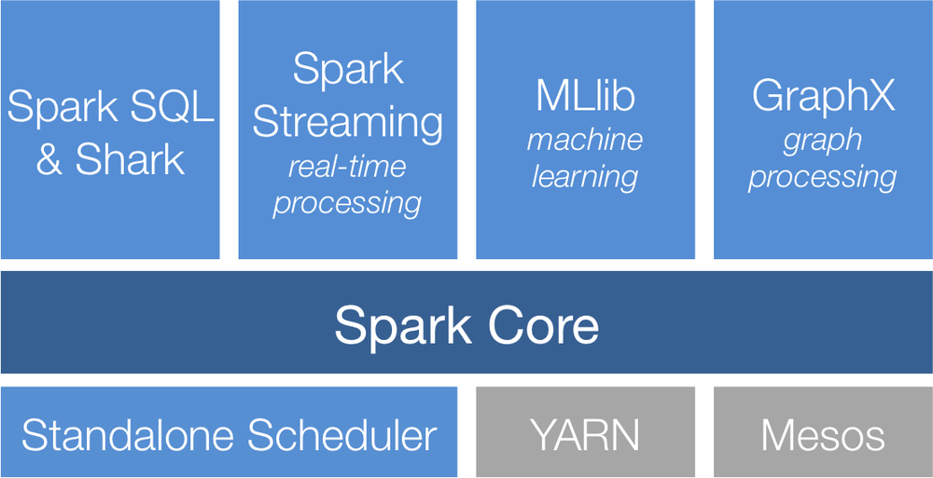
Apache Spark Introduction
A Unified Stack: multiple closely-integrated components

Slide 26
Apache Spark Introduction
Resilient Distributed Datasets (RDDs)
Spark Core is also home to the API that defines Resilient Distributed Datasets (RDDs), which are Spark’s main programming abstraction.
RDDs represent a collection of items distributed across many compute nodes that can be manipulated in parallel.
Spark Core provides many APIs for building and manipulating these collections.

Slide 27

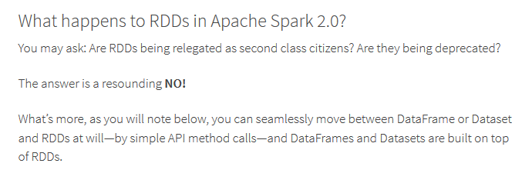
RDDs, DataFrames, and Datasets
A Tale of Three Apache Spark APIs: RDDs, DataFrames, and Datasets : When to use them and why
https://databricks.com/blog/2016/07/14/a-tale-of-three-apache-spark-apis-rdds-dataframes-and-datasets.html

Slide 28
RDDs, DataFrames, and Datasets
Summary:
RDD offers low-level functionality and control:
unstructured data, such as media streams or streams of text;
to manipulate data with functional programming constructs than domain specific expressions;
you don’t care about imposing a schema, such as columnar format, while processing or accessing data attributes by name or column
DataFrame and/or Dataset : to simplify Spark for developers, how to optimize and make it performant—we decided to elevate the low-level RDD APIs to a high-level abstraction
allow custom view and structure, offers high-level and domain specific operations, saves space, and executes at superior speeds.
https://databricks.com/blog/2016/07/14/a-tale-of-three-apache-spark-apis-rdds-dataframes-and-datasets.html

Slide 29
RDDs, DataFrames, and Datasets
You can always seamlessly interoperate or convert from DataFrame and/or Dataset to an RDD, by simple method call .rdd.
If you are a R user, use DataFrames.
If you are a Python user, use DataFrames and resort back to RDDs if you need more control.
https://databricks.com/blog/2016/07/14/a-tale-of-three-apache-spark-apis-rdds-dataframes-and-datasets.html

Slide 30
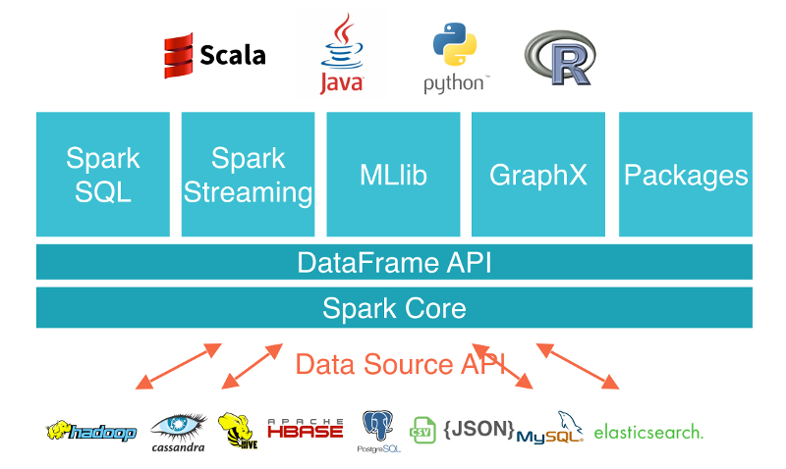

Slide 31
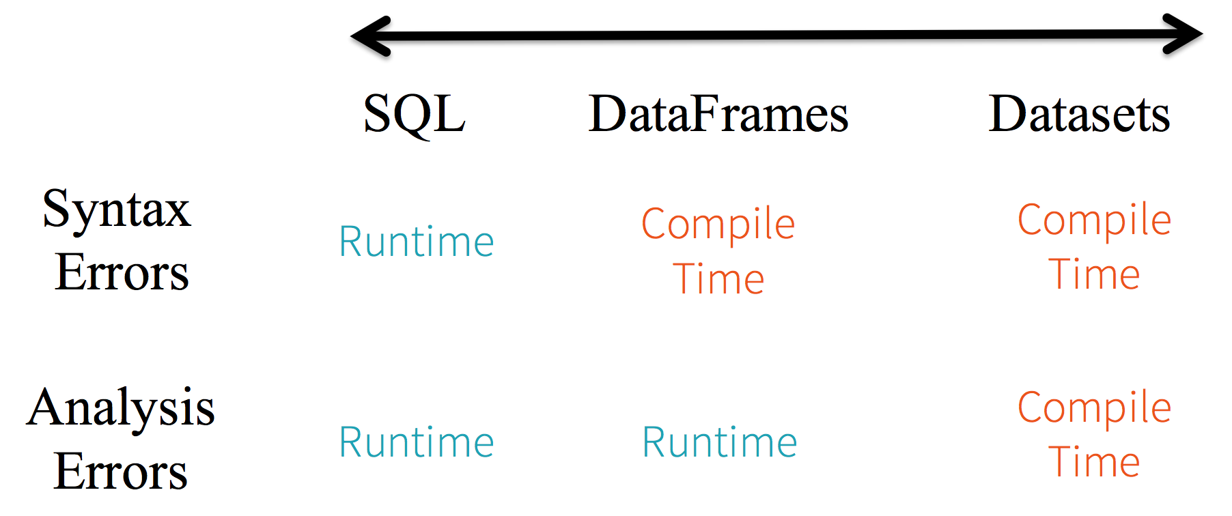
RDDs, DataFrames, and Datasets
https://databricks.com/blog/2016/07/14/a-tale-of-three-apache-spark-apis-rdds-dataframes-and-datasets.html

Slide 32
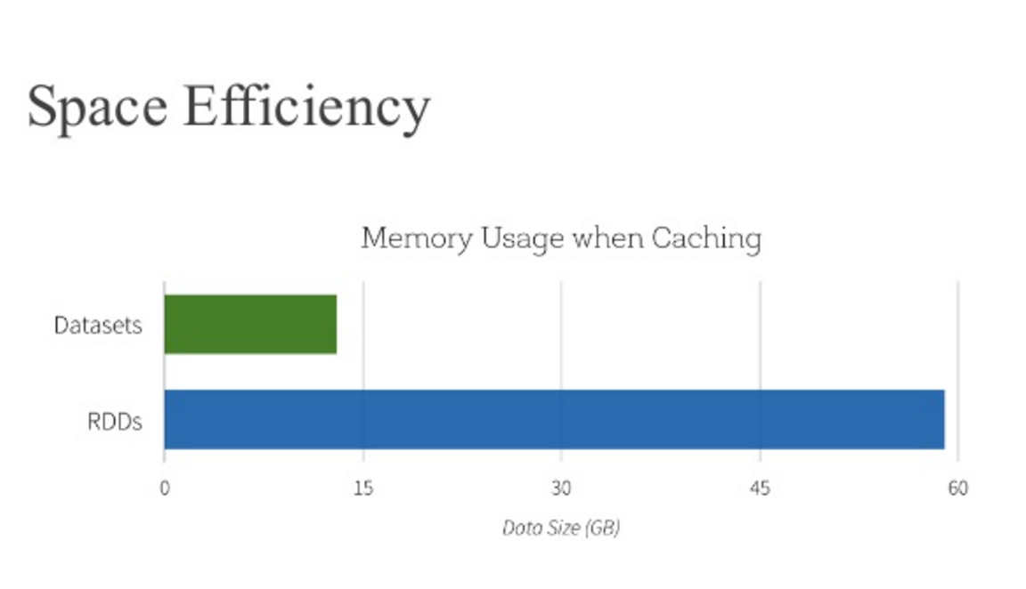
RDDs, DataFrames, and Datasets
https://databricks.com/blog/2016/07/14/a-tale-of-three-apache-spark-apis-rdds-dataframes-and-datasets.html

Slide 33

https://docs.databricks.com/getting-started/spark/quick-start.html
Spark interfaces
There are three key Spark interfaces that you should know about.
Resilient Distributed Dataset (RDD) ….. While this is the original data structure for Apache Spark, you should focus on the DataFrame API, which is a superset of the RDD functionality. The RDD API is available in the Java, Python, and Scala languages.
DataFrame: These are similar in concept to the DataFrame you may be familiar with in the pandas Python library and the R language. The DataFrame API is available in the Java, Python, R, and Scala languages.
Dataset: A combination of DataFrame and RDD. It provides the typed interface that is available in RDDs while providing the convenience of the DataFrame. The Dataset API is available in the Java and Scala languages.

Slide 34
https://docs.databricks.com/getting-started/spark/quick-start.html
Spark interfaces
In many scenarios, especially with the performance optimizations embedded in DataFrames and Datasets, it will not be necessary to work with RDDs. But it is important to understand the RDD abstraction because:
The RDD is the underlying infrastructure that allows Spark to run so fast and provide data lineage.
If you are diving into more advanced components of Spark, it may be necessary to use RDDs.
The visualizations within the Spark UI reference RDDs.
When you develop Spark applications, you typically use DataFrames and Datasets.

Slide 35

Apache Spark Introduction
Introduction to Core Spark Concepts
At a high level, every Spark application consists of a driver program that runs the user’s main function and executes various parallel operations on a cluster.

Slide 36
Apache Spark Introduction
Driver programs access Spark through a SparkContext object
The first thing a Spark program must do is to create a SparkContext object, which tells Spark how to access a cluster.
To create a SparkContext you first need to build a SparkConf object that contains information about your application.

Slide 37
Historically, Apache Spark has had two core contexts that are available to the user.
The sparkContext made available as sc
and the SQLContext made available as sqlContext
The sqlContext makes a lot of DataFrame functionality available while the sparkContext focuses more on the Apache Spark engine itself.
However in Apache Spark 2.X, there is just one context - the SparkSession

Slide 38
Apache Spark Introduction
the previously mentioned SparkSession. We can access it via the spark variable
Using the Python Shell or Jupyter notebooks in Databricks, IBM workbenches….
SparkContext object is automatically created for you
Check: SparkSession can be accessed via the spark variable

Slide 39
… intro break, let’s start playing with:

Slide 40
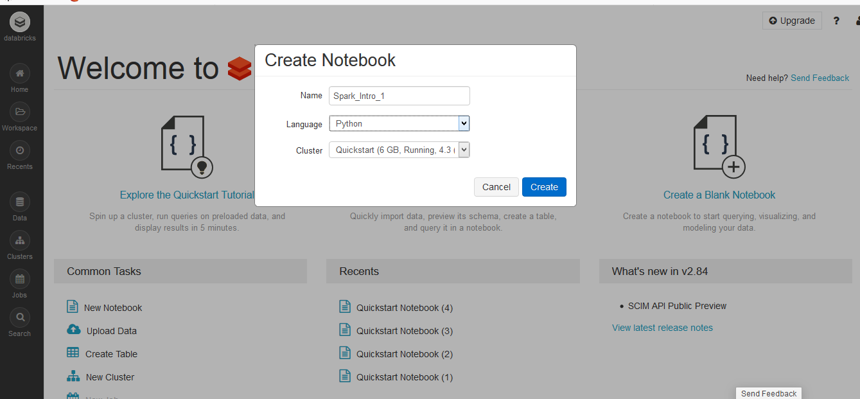
… create a Blank Notebook (Python, but note other…):

Slide 41
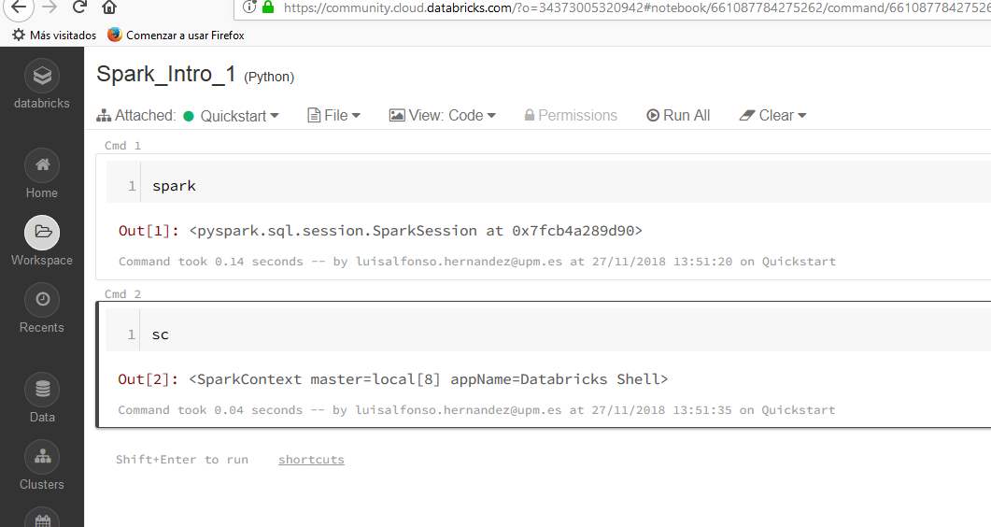
… if attached to a cluster, see SparkContext typing sc:

Slide 42
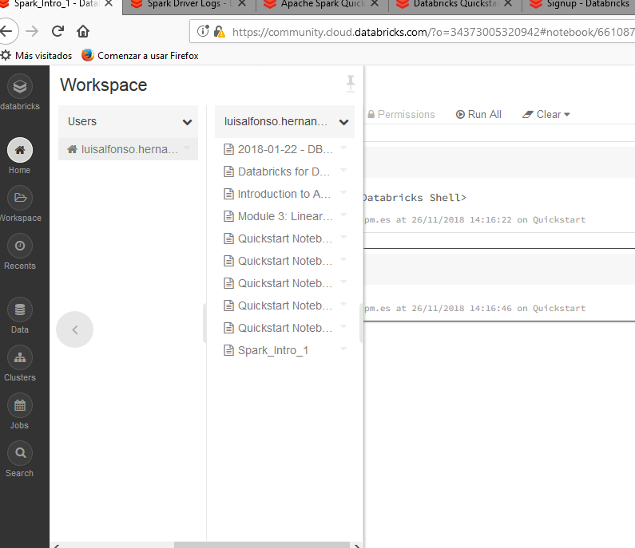
… locate Spark_Intro_1.ipynb in Databricks Workspace
learn that you can: import /export

Slide 43
MSTC_Intro_Apache_Spark_on_Databricks.ipynb
Import this notebook from:
https://github.com/MasterMSTC/PySpark_DataFrames_MLib/blob/master/MSTC_Intro_Apache_Spark_on_Databricks.ipynb
… and attach it to a Cluster (Quickstart)
-----------------------------------------------------
NOTE some peculiarities:
Dashboards
Dashboards can be created from notebooks as a way of displaying the output of cells without the code that generates them.
Notebooks can also be scheduled as jobs in one click either to run a data pipeline, update a machine learning model, or update a dashboard.

Slide 44
Programming with RDDS
Once you have a SparkContext you can use it to build RDDs in two ways :
parallelizing an existing collection in your driver program,
or referencing a dataset in an external storage system, such as a shared filesystem, HDFS, HBase, or any data source offering a Hadoop InputFormat.

Slide 45
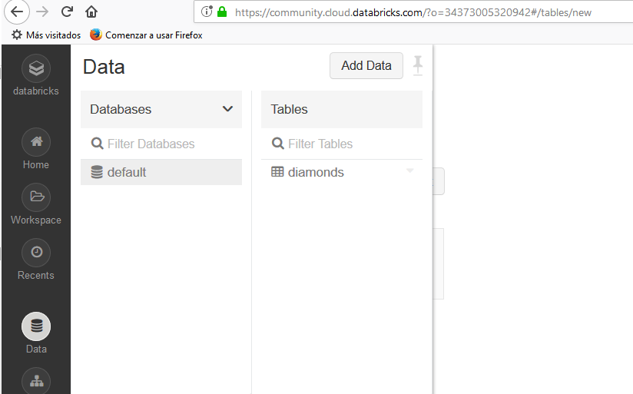
Learn how to upload data

Slide 46
Programming with RDDS
Resilient Distributed Data Sets are simply immutable distributed collection of elements.
RDDs can contain any type of Python, R, Java or Scala objects. Including user-defined classes.
RDDs can be created in two ways:
loading an external dataset;
data_file = "churn_bigml_80.csv"
raw_data = sc.textFile(data_file)
or by distributing a collection of objects (e.g. a list or set) in the driver program.

Slide 47
Programming with RDDS
We will follow
WORKING_MSTC_Spark_rdd_intro.ipynb

Slide 48
Programming with RDDS
RDDs support two types of Operations:
Transformations: return a new RDD, as map() and filter()
Actions: return a result to the driver program or write it to storage, such as count() and first()
Spark treats transformations and actions very differently !!!

Slide 49
Programming with RDDS
Transformations
Are computed lazily : only when they are used in actions
… we will discus this later and see it in the example notebooks

Slide 50
Programming with RDDS
Actions
do something with a RDD: take() collect() count()
Return a final value to the driver program or write data to an external storage system

Slide 51
Programming with RDDS
Common Actions:
Actions
RDD.collect() returns the entire RDD’s contents. collect suffers from the restriction that all of your data must fit on a single machine, as it all needs to be copied to the driver.
RDD.take(n) returns n elements from the RDD and attempts to minimize the number of partitions it accesses, so it may represent a biased collection. Its important to note that these operations do not return the elements in the order you might expect. takeOrdered(num)(ordering) return num elements based on providing ordering
Note: These operations are useful for unit tests and quick debugging, but may introduce bottlenecks when dealing with large amounts of data.

Slide 52
Programming with RDDS
Common Actions:
Actions (cont.)
RDD.count() number of elements in the RDD.
RDD.top(n) If there is an ordering defined on our data, extracts the top elements from an RDD using top. top will use the default ordering on the data, but we can supply our own comparison function to extract the top elements.
RDD.countByValue(n) number of times each element occurs in the RDD

Slide 53
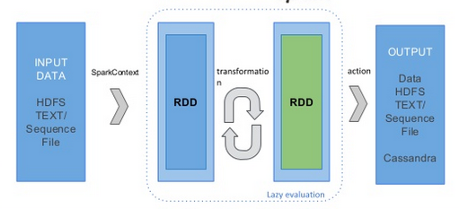
Programming with RDDS
Schematic representation of Transformations and Actions

Slide 54
Programming with RDDS
Lazy Evaluation
Lazy evaluation reduces the number of passes to take over data by grouping operations together.
In MapReduce systems like Hadoop, developers often have to spend a lot time considering how to group together operations to minimize the number of MapReduce passes.
In Spark, there is no substantial benefit to writing a single complex map instead of chaining together many simple operations. Thus, users are free to organize their program into smaller, more manageable operations.

Slide 55
Programming with RDDS
In the Notebook: nb2-rdd-basics.ipynb
(or in RDD_BASIC_OPERATIONS.ipynb)
You can see:
Transformations: filter() and map()
Actions: count(), take() and collect()
..and experiment Lazy evaluation…

Slide 56
Programming with RDDS
Common Transformations and Actions:
Element-wise transformations
map() : takes in a function and applies it to each element in the RDD with the result of the function being the new value of each element in the resulting RDD.
filter() : take in a function and returns an RDD which only has elements that pass the filter function.
(See examples in Notebook: RDD_BASIC_OPERATIONS.ipynb)
Note: the return type of the map does not have to be the same as the input type, so if we had an RDD of customer IDs and our map function were to fetch the corresponding customer records the type of our input RDD would be RDD[CustomerID] and the type of the resulting RDD would be RDD[CustomerRecord].

Slide 57
Programming with RDDS
Common Transformations and Actions:
Element-wise transformations
flatMap() : Sometimes we want to produce multiple output elements for each input element. The operation to do this is called flatMap. Like with map, the function we provide to flatMap is called individually for each element in our input RDD. Instead of returning a single element, we return an iterator with our return values. Rather than producing an RDD of iterators, we get back an RDD which consists of the elements from all of the iterators. A simple example of flatMap is splitting up an input string into words.
(See example in Notebook: RDD_BASIC_OPERATIONS.ipynb)

Slide 58
Programming with RDDS
In Notebook: nb3-rdd-sampling.ipynb
You will see two sampling operations, the transformation sample and the action takeSample.
Transformation:
sample takes up to three parameters: 1) with replacement or not 2) sample size as a fraction, and 3) we can optionally provide a random seed.
The power of sampling as a transformation comes from doing it as part of a sequence of additional transformations. This will show more powerful once we start doing aggregations and key-value pairs operations, and will be specially useful when using Spark's machine learning library MLlib

Slide 59
Programming with RDDS
Notebook: nb3-rdd-sampling.ipynb (cont.)
Action:
takeSample we retrieve a given sample and we can have it in local memory to be used by any other standard library (e.g. Scikit-learn)
The syntax is very similar, but in this case we specify the number of items instead of the sample size as a fraction of the complete data size

Slide 60
Programming with RDDS
Notebook: nb4-rdd-set.ipynb (cont.)
Spark supports operations in mathematical sets, such as union and intersection, even when the RDDs themselves are not properly sets.
It is important to note that these operations require that the RDDs being operated on are of the same type
Because RDDs are not real sets, operations such as the union of RDDs doesn't remove duplicates.
In this notebook we will have a brief look at subtract, distinct, and cartesian

Slide 61
Programming with RDDS
Common Transformations and Actions:
Pseudo set operations
RDDs support many of the operations of mathematical sets, such as union and intersection, even when the RDDs themselves not properly sets.
RDD.distinct() produce a new RDD with only distinct items. Note that distinct() is expensive, however, as it requires shuffling all the data over the network to ensure that we only receive one copy of each element.
RDD.union(other) which gives back an RDD consisting of the data from both sources. Unlike the mathematical union(), if there are duplicates in the input RDDs, the result of Spark’s union() will contain duplicates (which we can fix if desired with distinct().

Slide 62
Programming with RDDS
Common Transformations and Actions:
Pseudo set operations (cont.)
RDD.intersection(other) returns only elements in both RDDs. intersection() also removes all duplicates (including duplicates from a single RDD) while running.
While intersection and union are to very similar concepts, the performance of intersection is much worse since it requires a shuffle over the network to identify common elements.
RDD.subtract(other) takes in another RDD and returns an RDD that only has values present in the first RDD and not the second RDD.

Slide 63
Programming with RDDS
Common Transformations and Actions:
Pseudo set operations (cont.)
RDD.cartesian(other) compute a Cartesian product between two RDDs. resulting in possible pairs of (a, b) where a is in the source RDD and b is in the other RDD.
The Cartesian product can be useful when we wish to consider the similarity between all possible pairs, such as computing every users expected interests in each offer.
Note: Cartesian product is very expensive for large RDDs
(See examples in Notebook: RDD_BASIC_OPERATIONS.ipynb)

Slide 64
Programming with RDDS
In Notebook: nb5-rdd-aggregations.ipynb
We can aggregate RDD data in Spark by using three different actions: reduce, fold, and aggregate. The last one is the more general one and someway includes the first two.

Slide 65
Programming with RDDS
Common Transformations and Actions:
Actions
RDD.reduce() is the most common action on basic RDDs. Reduce takes in a function which operates on two elements of the same type of your RDD and returns a new element of the same type.
A simple example of such a function is + , which we can use to sum our RDD. With reduce we can easily sum the elements of our RDD, count the number of elements, and perform other types of aggregation
RDD.fold() similar to reduce but takes a “zero value” to be used for the initial call on each partition. The zero value you provide should be the identity element for your operation, that is applying it multiple times with your function should not change the value, (e.g. 0 for +, 1 for *, or an empty list for concatenation).

Slide 66
Programming with RDDS
Common Transformations and Actions:
Actions (cont.)
Fold and reduce both require that the return type of our result be the same type as that of the RDD we are operating over.
But sometimes we want to return a different type. For example when computing the running average we need to have a different return type.
We could implement this using a map first where we transform every element into the element and the number 1 so that the reduce function can work on pairs.
But this can be avoided using aggregate()

Slide 67
Programming with RDDS
Common Transformations and Actions:
Actions (cont.)
RDD.aggregate() With aggregate, like fold, we supply an initial zero value of the type we want to return. We then supply a function to combine the elements from our RDD with the accumulator. Finally, we need to supply a second function to merge two accumulators, given that each node accumulates its own results locally.
Example: average of a RDD
sumCount = nums.aggregate((0, 0),
(lambda acc, value: (acc[0] + value, acc[1] + 1)),
# This operation is applied locally to each partition in parallel.
(lambda acc1, acc2: (acc1[0] + acc2[0], acc1[1] + acc2[1])))
# This operation will reduce the partial results of each partition and produce the actual total.
return sumCount[0] / float(sumCount[1])

Slide 68
Programming with RDDS
In Notebook: nb6-rdd-key-value.ipynb
Spark provides specific functions to deal with RDDs which elements are key/value pairs. They are usually used to perform aggregations and other processings by key.
We can use all the transformations and actions available for normal RDDs with key/value pair RDDs.
We just need to make the functions work with pair elements.
Additionally, Spark provides specific functions to work with RDDs containing pair elements. They are very similar to those available for general RDDs.

Slide 69
Programming with RDDS
In Notebook: nb6-rdd-key-value.ipynb (cont.)
This notebook illustrates the possibilities of working with key/value pairs to process network interactions.
In this example, key/value pair aggregations will show to be particularly effective when trying to explore each type of tag in our network attacks, in an individual way.

Slide 70
Programming with RDDS
Working with Key-Value Pairs (intro)
While most Spark operations work on RDDs containing any type of objects, a few special operations are only available on RDDs of key-value pairs. The most common ones are distributed “shuffle” operations, such as grouping or aggregating the elements by a key.
In Python, these operations work on RDDs containing built-in Python tuples such as (1, 2). Simply create such tuples and then call your desired operation.
For example, the following code uses the reduceByKey operation on key-value pairs to count how many times each line of text occurs in a file:
lines = sc.textFile("data.txt")
pairs = lines.map(lambda s: (s, 1))
counts = pairs.reduceByKey(lambda a, b: a + b)
We could also use counts.sortByKey(), for example, to sort the pairs alphabetically, and finally counts.collect() to bring them back to the driver program as a list of objects.
…see examples using in RDD_BASIC_OPERATIONS Notebook

Slide 71
Programming with RDDS
The combineByKey Method
Turns an RDD[(K, V)] into a result of type RDD[(K, C)], for a “combined type” C. Note that V and C can be different – for example, one might group an RDD of type (Int, Int) into an RDD of type (Int, List[Int])
In order to aggregate an RDD’s elements in parallel, Spark’s combineByKey method requires three functions:
* createCombiner:
First we need to create a combiner function which is essentially a tuple = (value, 1) for every key encountered in each partition. After this phase the output for every (key, value) in a partition is (key, (value, 1)).
* mergeValue
Then on the next iteration the combiner functions per partition is merged using the merge value function for every key. After this phase the output of every (key, (value, 1)) is (key, (total, count)) in every partition.
* mergeCombiner
Finally the merge combiner function merges all the values across the partitions in the executors and sends the data back to the driver. After this phase the output of every (key, (total, count)) per partition is (key, (totalAcrossAllPartitions, countAcrossAllPartitions)).

Slide 72
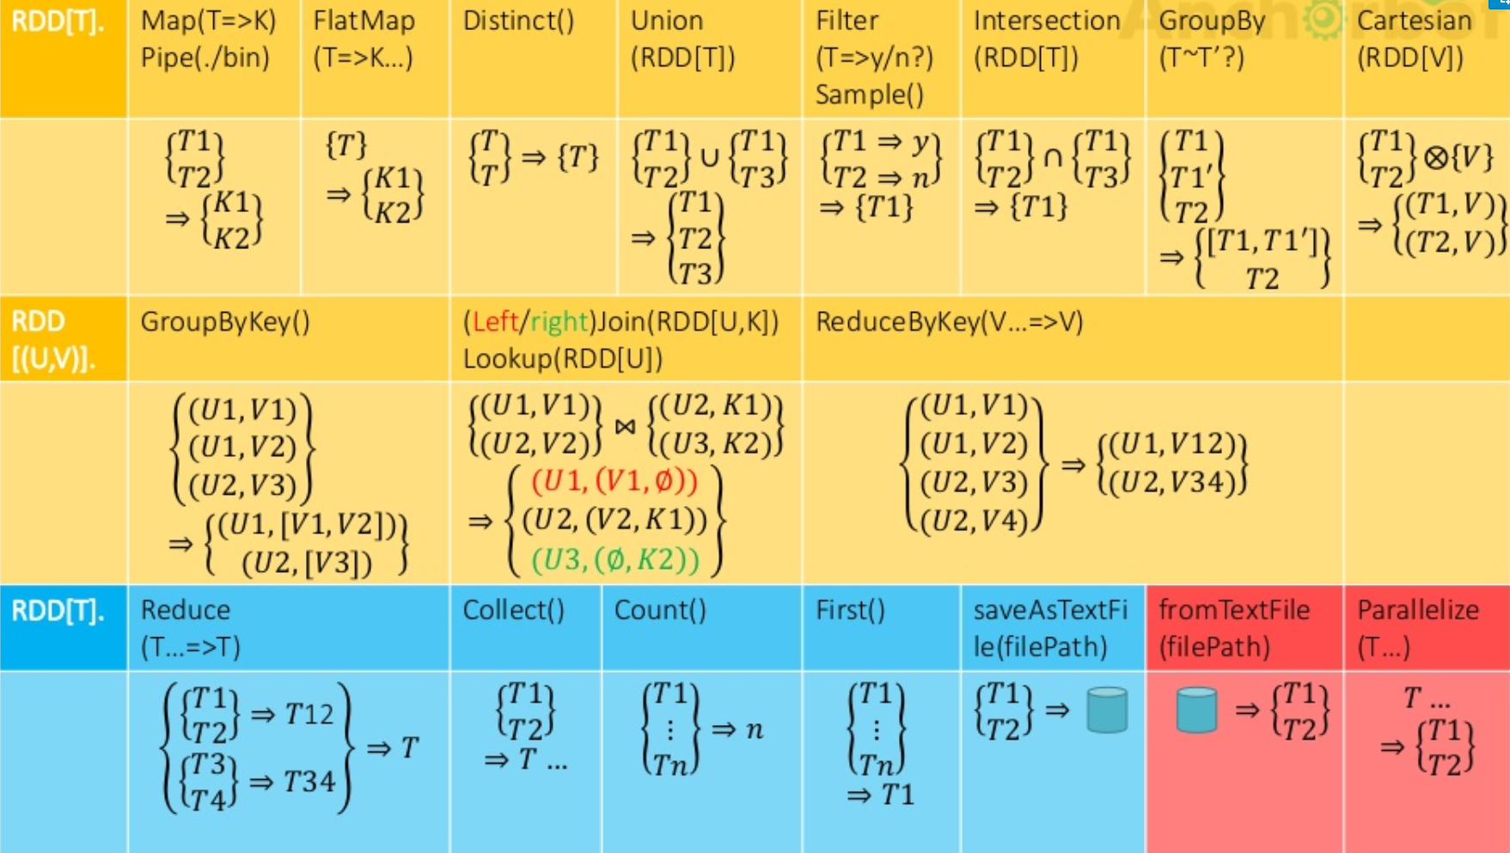
Apache Spark Introduction
Google Data Center

Slide 73
Programming with RDDS
Other more advanced topics…
Some simple examples in RDD_BASIC_OPERATIONS.ipynb

Slide 74
Programming with RDDS
Passing Functions to Spark
Most of Spark transformations, and some of its actions, depend on passing in functions that are used by Spark to compute data. Each of the core languages has a slightly different mechanism for passing functions to Spark.
In Python, we have three options for passing functions into Spark:
For shorter function we can pass in lambda expressions
We can also pass in top-level functions, or locally defined functions
(see Notebook RDD_BASIC_OPERATIONS.ipynb simple example)

Slide 75
Programming with RDDS
Issues when Passing Functions to Spark
One issue to watch out for when passing functions if that if you pass functions that are members of an object, or references to fields in an object (e.g., self.field), this results in sending in the entire object, which can be much larger than just the bit of information you need. Sometimes this can also cause your program to fail, if your class contains objects that Python can’t figure out how to pickle.
Example Passing a function with field references (don’t do this!)
class SearchFunctions(object):
def __init__(self, query):
self.query = query
def isMatch(self, s):
return query in s
def getMatchesFunctionReference(self, rdd):
# Problem: references all of "self" in "self.isMatch"
return rdd.filter(self.isMatch)
def getMatchesMemberReference(self, rdd):
# Problem: references all of "self" in "self.query"
return rdd.filter(lambda x: self.query in x)

Slide 76
Programming with RDDS
Issues when Passing Functions to Spark (cont.)
Instead, just extract the fields you need from your object into local variable and pass that in, like we do below:
Example : Python function passing without field references
class WordFunctions(object):
...
def getMatchesNoReference(self, rdd):
# Safe: extract only the field we need into a local variable
query = self.query
return rdd.filter(lambda x: query in x)

Slide 77
Programming with RDDS
Common Transformations and Actions:
Actions…
RDD.foreach(). Perform computations on each element in the RDD without bringing it back locally. For example, inserting records into a database.
# Buid a RDD
numRDD2 = sc.parallelize([6, 2, 3, 4, 5, 6, 7, 9])
# Why this do nothing!
def f(x):
print x
numRDD2.foreach(f)
Understanding closures …..

Slide 78
Programming with RDDS
Understanding closures :
One of the harder things about Spark is understanding the scope and life cycle of variables and methods when executing code across a cluster.
RDD operations that modify variables outside of their scope can be a frequent source of confusion.
See the examples using foreach() in RDD_BASIC_OPERATIONS.ipynb
… similar issues can occur for other operations as well.

Slide 79
Programming with RDDS
Understanding closures :
Local vs. cluster modes
To execute jobs, Spark breaks up the processing of RDD operations into tasks - each of which is operated on by an executor.
Prior to execution, Spark computes the closure. The closure is those variables and methods which must be visible for the executor to perform its computations on the RDD (in this case foreach()). This closure is serialized and sent to each executor.
In local mode, there is only one executor so everything shares the same closure. In other modes however, this is not the case and the executors running on separate worker nodes each have their own copy of the closure.

Slide 80
Programming with RDDS
Understanding closures :
Local vs. cluster modes (cont)
What is happening in the Notebook example is that the variables within the closure sent to each executor are now copies and thus, when counter is referenced within the foreach function, it’s no longer the counter on the driver node.
There is still a counter in the memory of the driver node but this is no longer visible to the executors! The executors only sees the copy from the serialized closure.
Thus, the final value of counter will still be zero since all operations on counter were referencing the value within the serialized closure.

Slide 81
Programming with RDDS
Understanding closures
To ensure well-defined behavior in these sorts of scenarios one should use an Accumulator.
Accumulators in Spark are used specifically to provide a mechanism for safely updating a variable when execution is split up across worker nodes in a cluster. In general, closures - constructs like loops or locally defined methods, should not be used to mutate some global state.
Spark does not define or guarantee the behavior of mutations to objects referenced from outside of closures. Some code that does this may work in local mode, but that’s just by accident and such code will not behave as expected in distributed mode.
Use an Accumulator instead if some global aggregation is needed.
…as it is done using foreach() in RDD_BASIC_OPERATIONS.ipynb

Slide 82
Programming with RDDS
Shared Variables
Normally, when a function passed to a Spark operation (such as map or reduce) is executed on a remote cluster node, it works on separate copies of all the variables used in the function. These variables are copied to each machine, and no updates to the variables on the remote machine are propagated back to the driver program.
Supporting general, read-write shared variables across tasks would be inefficient.
However, Spark does provide two limited types of shared variables for two common usage patterns:
broadcast variables;
and accumulators.

Slide 83
Programming with RDDS
Shared Variables
broadcast variables
Keep a read-only variable cached on each machine rather than shipping a copy of it with tasks. They can be used, for example, to give every node a copy of a large input dataset in an efficient manner. Spark also attempts to distribute broadcast variables using efficient broadcast algorithms to reduce communication cost.
Spark actions are executed through a set of stages, separated by distributed “shuffle” operations. Spark automatically broadcasts the common data needed by tasks within each stage. The data broadcasted this way is cached in serialized form and deserialized before running each task. This means that explicitly creating broadcast variables is only useful when tasks across multiple stages need the same data or when caching the data in deserialized form is important.

Slide 84
Programming with RDDS
Shared Variables
broadcast variables
Broadcast variables are created from a variable v by calling SparkContext.broadcast(v). The broadcast variable is a wrapper around v, and its value can be accessed by calling the value method. The code below shows this:
>>> broadcastVar = sc.broadcast([1, 2, 3])
<pyspark.broadcast.Broadcast object at 0x102789f10>
>>> broadcastVar.value
[1, 2, 3]
After the broadcast variable is created, it should be used instead of the value v in any functions run on the cluster so that v is not shipped to the nodes more than once.
In addition, the object v should not be modified after it is broadcast in order to ensure that all nodes get the same value of the broadcast variable (e.g. if the variable is shipped to a new node later).

Slide 85
Programming with RDDS
Shared Variables
Accumulators
Accumulators are variables that are only “added” to through an associative operation and can therefore be efficiently supported in parallel. They can be used to implement counters (as in MapReduce) or sums.
Spark natively supports accumulators of numeric types, and programmers can add support for new types. If accumulators are created with a name, they will be displayed in Spark’s UI. This can be useful for understanding the progress of running stages (NOTE: this is not yet supported in Python).

Slide 86
Programming with RDDS
Shared Variables
Accumulators
An accumulator is created from an initial value v by calling SparkContext.accumulator(v). Tasks running on the cluster can then add to it using the add method or the += operator (in Scala and Python). However, they cannot read its value. Only the driver program can read the accumulator’s value, using its value method.
The code below shows an accumulator being used to add up the elements of an array:
>>> accum = sc.accumulator(0)
Accumulator<id=0, value=0>
>>> sc.parallelize([1, 2, 3, 4]).foreach(lambda x: accum.add(x))
accum.value

Slide 87
Programming with RDDS
Persistence (Caching)
As discussed earlier, Spark RDDs are lazily evaluated, and sometimes we may wish to use the same RDD multiple times.
If we do this naively, Spark will recompute the RDD and all of its dependencies each time we call an action on the RDD. This can be especially expensive for iterative algorithms, which look at the data many times. Another trivial example would be doing a count and then writing out the same RDD.
To avoid computing an RDD multiple times, we can ask Spark to persist the data. When we ask Spark to persist an RDD, the nodes that compute the RDD store their partitions. If a node that has data persisted on it fails, Spark will recompute the lost partitions of the data when needed. We can also replicate our data on multiple nodes if we want to be able to handle node failure without slowdown.

Slide 88
Programming with RDDS
Persistence (Caching)
Spark has many levels of persistence to chose from based on what our goals are. In Scala and Java, the default persist() will store the data in the JVM heap as unserialized objects.
In Python, we always serialize the data that persist stores, so the default is instead stored in the JVM heap as pickled objects. When we write data out to disk or off-heap storage that data is also always serialized.
If you attempt to cache too much data to fit in memory, Spark will automatically evict old partitions using a Least Recently Used (LRU) cache policy. For the memory-only storage levels, it will recompute these partitions the next time they are accessed, while for the memory-and-disk ones, it will write them out to disk. In either case, this means that you don’t have to worry about your job breaking if you ask Spark to cache too much data. However, caching unnecessary data can lead to eviction of useful data and more recomputation time.
Finally, RDDs come with a method called unpersist() that lets you manually remove them from the cache.

Slide 89
Programming with RDDS
Persistence (Caching)
Note: In Python, stored objects will always be serialized with the Pickle library, so it does not matter whether you choose a serialized level.
Spark also automatically persists some intermediate data in shuffle operations (e.g. reduceByKey), even without users calling persist. This is done to avoid recomputing the entire input if a node fails during the shuffle. We still recommend users call persist on the resulting RDD if they plan to reuse it.

